Slide 1
What makes a Strong football team?
Kayla Thompson – dsc 530 final project

Slide 2
Variables included in analysis
Offensive Touchdowns – number of touchdowns the offense scores in a season
Points Per Game – number of points on average a team scores per game
Penalties – number of penalties a team earns in a season
Total Touchdowns Allowed – number of touchdowns a team allows in a season
Turnovers Gained – number of times a team causes a turnover and gains possession of the football
Offensive Yards Per Game – number of yards the offense moves the ball in a game
Yards Allowed Per Game – number of yards allowed by the defense per game
Touchdowns Allowed Per Game - number of touchdowns allowed by the defense per game
Opponent First Downs – number of first downs the opponent earns in a game

Slide 3
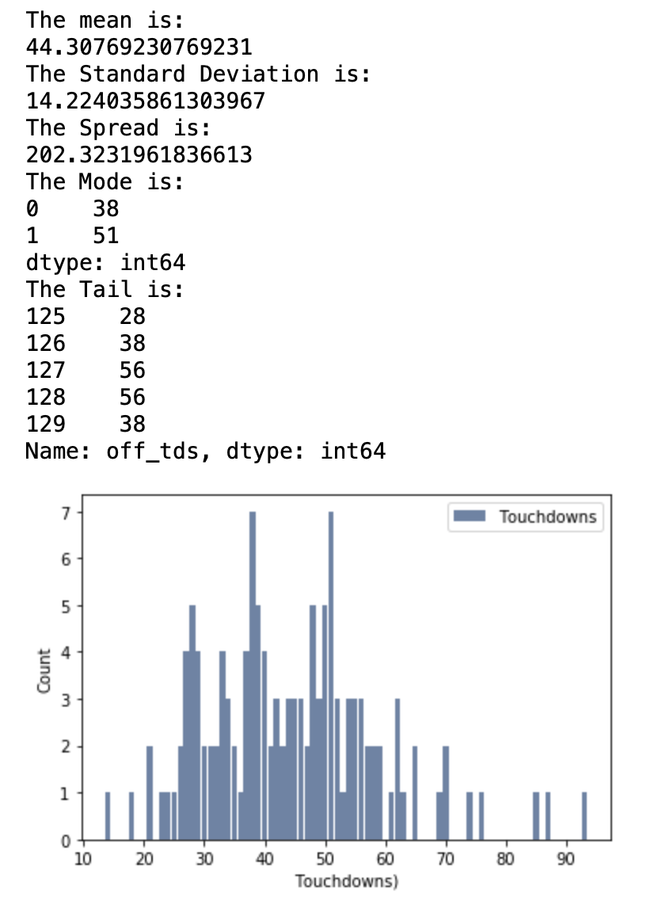
Variable #1
No outliers detected

Slide 4
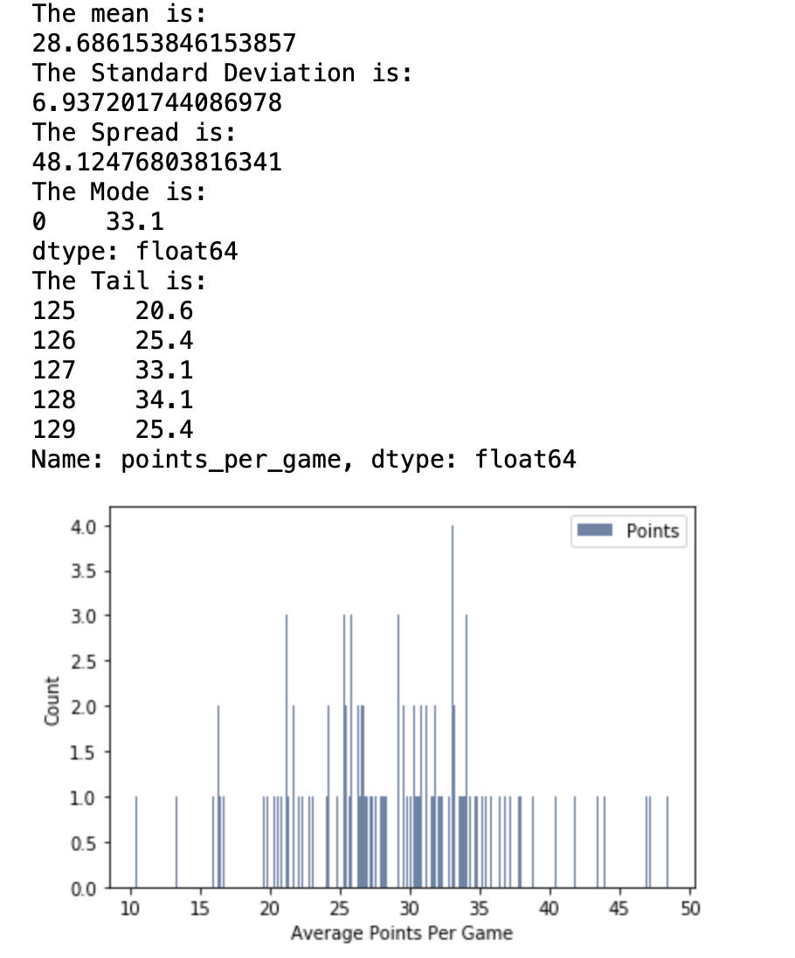
Variable #2
No outliers detected

Slide 5
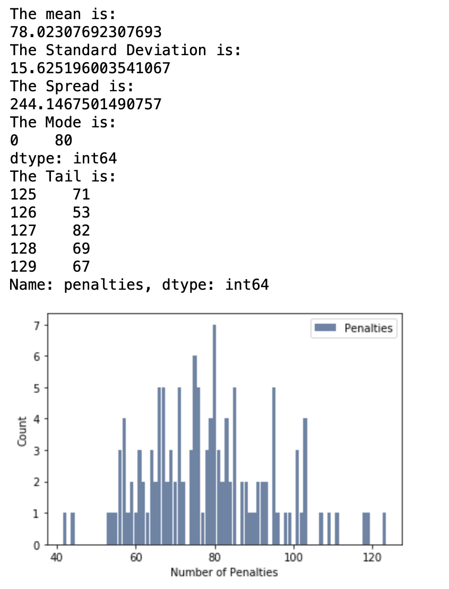
Variable #3
No outliers detected

Slide 6
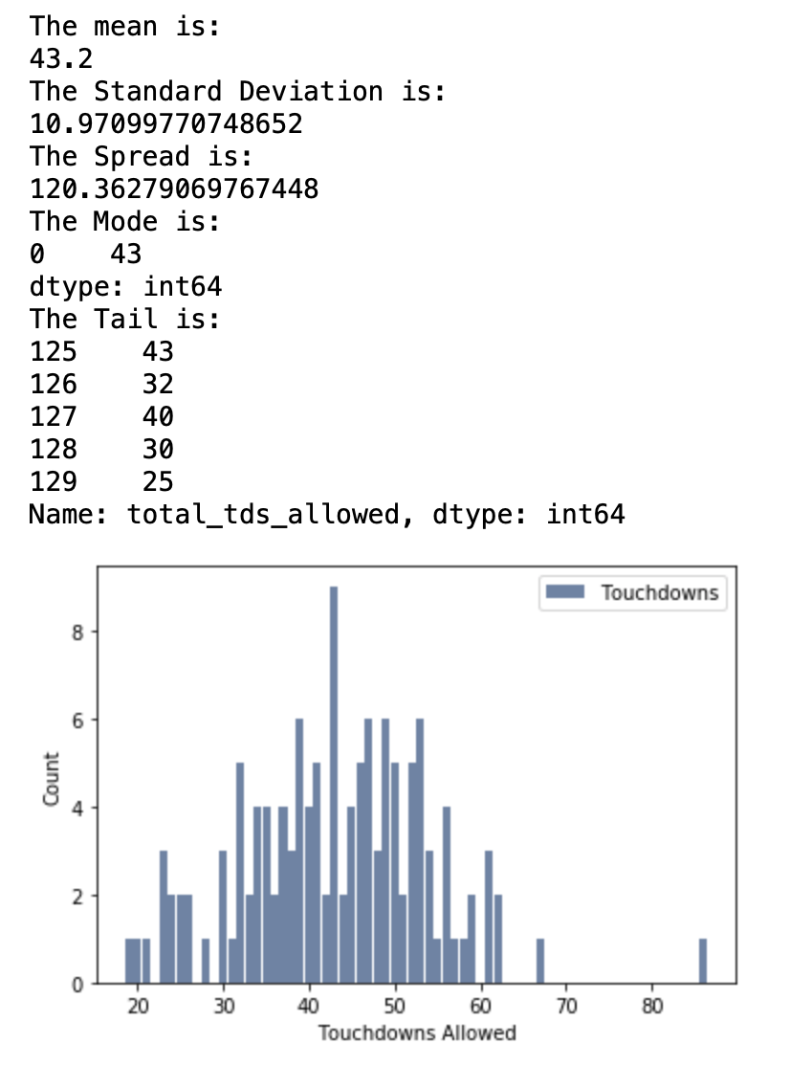
Variable #4
No outliers detected

Slide 7
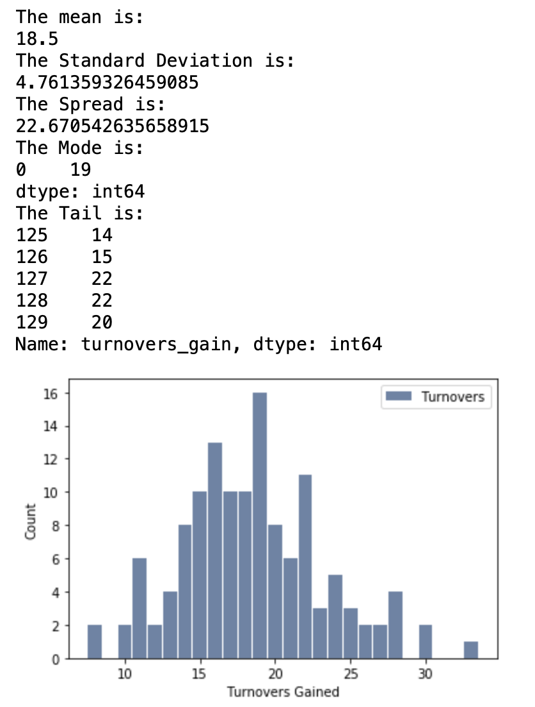
Variable #5
No outliers detected

Slide 8
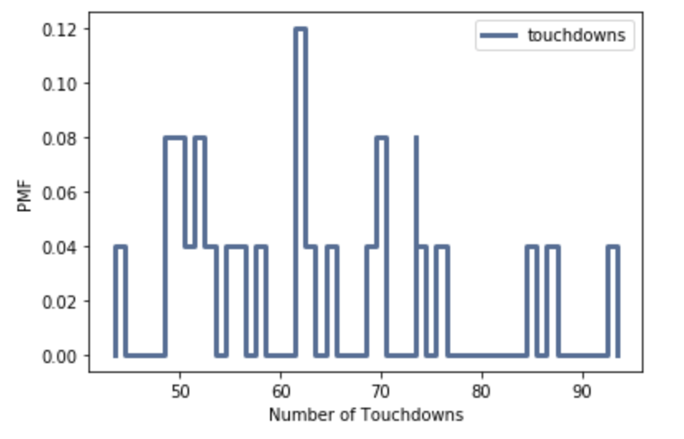
PMf – Elite football teams
I filtered the data for football teams with an offense ranked in the top 25 of all the offenses in the data set.
Two sets were generated, elite and other
PMF generated for the elite group and the number of touchdowns they scored in a season

Slide 9
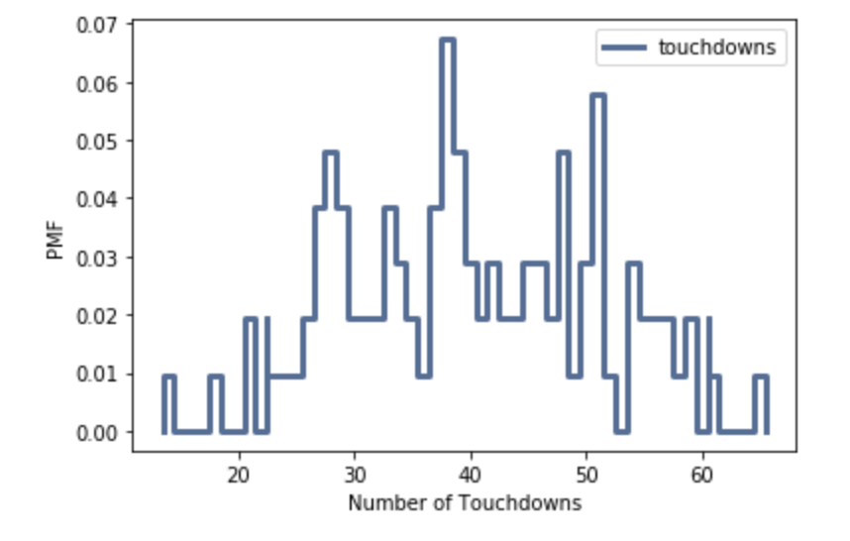
PMf – Other football teamS
I filtered the data for football teams with an offense ranked in the top 25 of all the offenses in the data set.
Two sets were generated, elite and other
PMF generated for the other group and the number of touchdowns they scored in a season

Slide 10
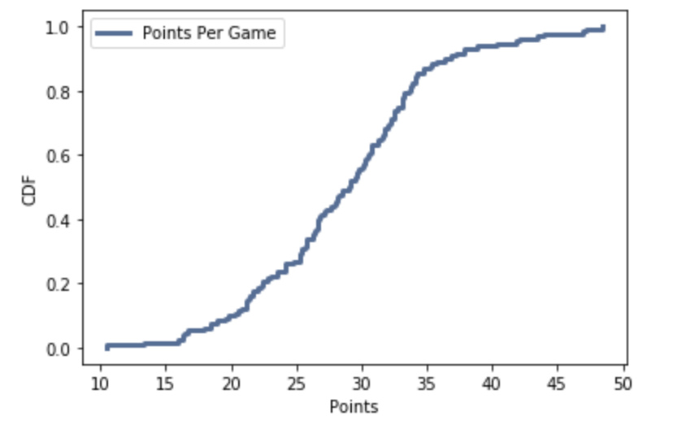
CDF – points per game
When evaluating a CDF – common values will be more vertical and less common values will be more flat.
Looking at our graph of our CDF, the graph is the most vertical between 25 and 35 points, leveling off before and after that range.
From this, we can conclude that most teams are scoring on average between 25 and 35 points per game. Very few score less than that and very few score more than that.

Slide 11
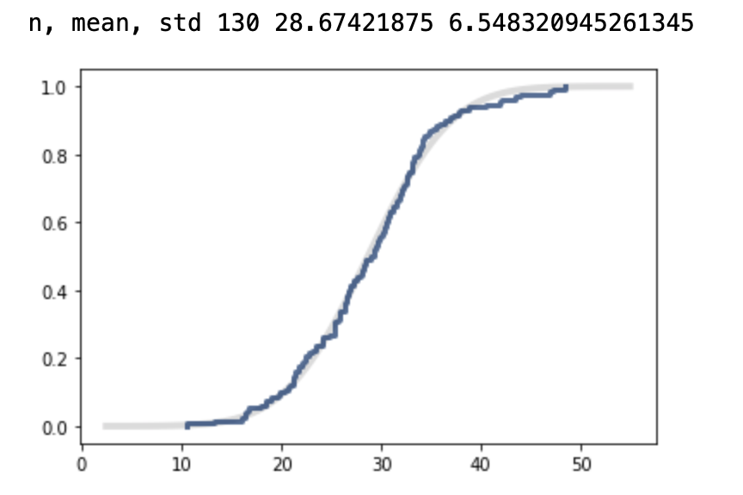
Analytical model
Normal Model used
CDF of Normal Model shown
Data shows little deviation from the normal model line. From this, we conclude that then normal model is a good fit for our distribution of points per game.

Slide 12
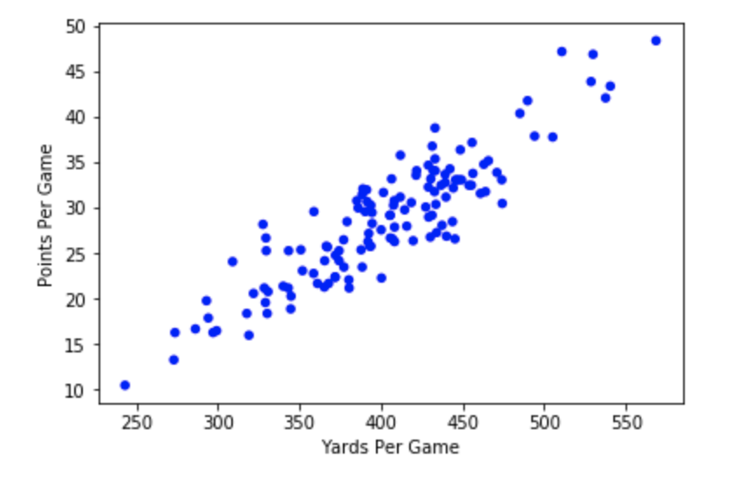
Scatter Plot #1 yards vs. points
Covariance of Yards and Points
366.4912
Correlation of Yards and Points
0.90206
Spearman Correlation of Yards and Points
0.86520

Slide 13
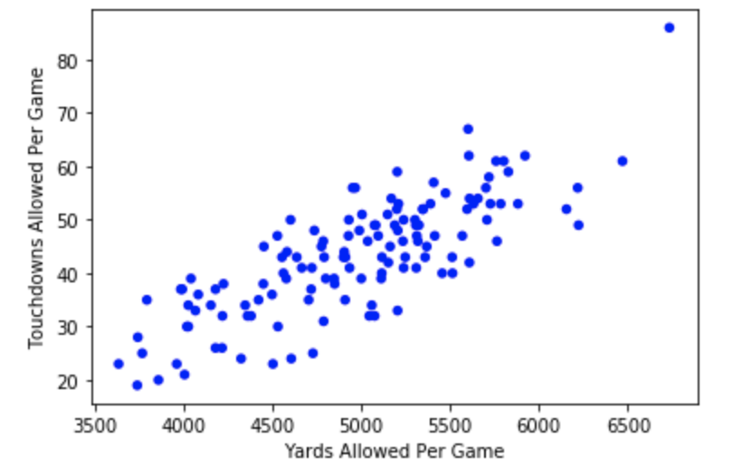
Scatter Plot #2 Opponent yards vs. Opponent points
Covariance of Yards and Points
5449.169
Correlation of Yards and Points
0.79948
Spearman Correlation of Yards and Points
0.791056

Slide 14
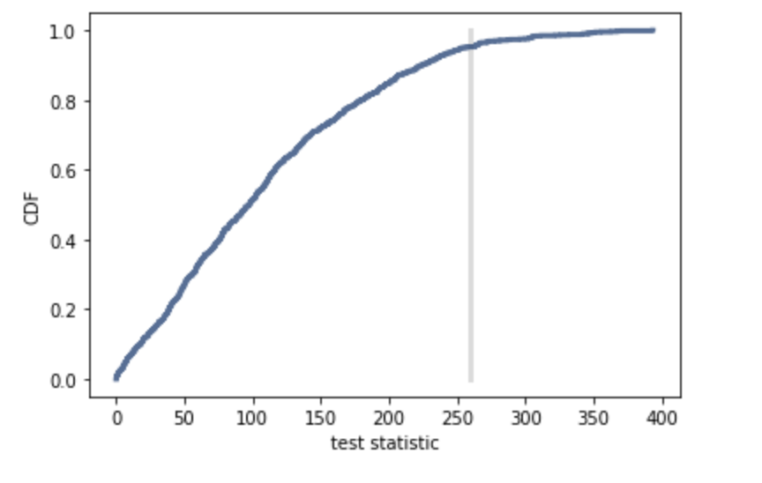
Hypothesis test
P Value: 0.047 – significant!
Hypothesis test suggests that defenses play a role in the performance of offenses

Slide 15
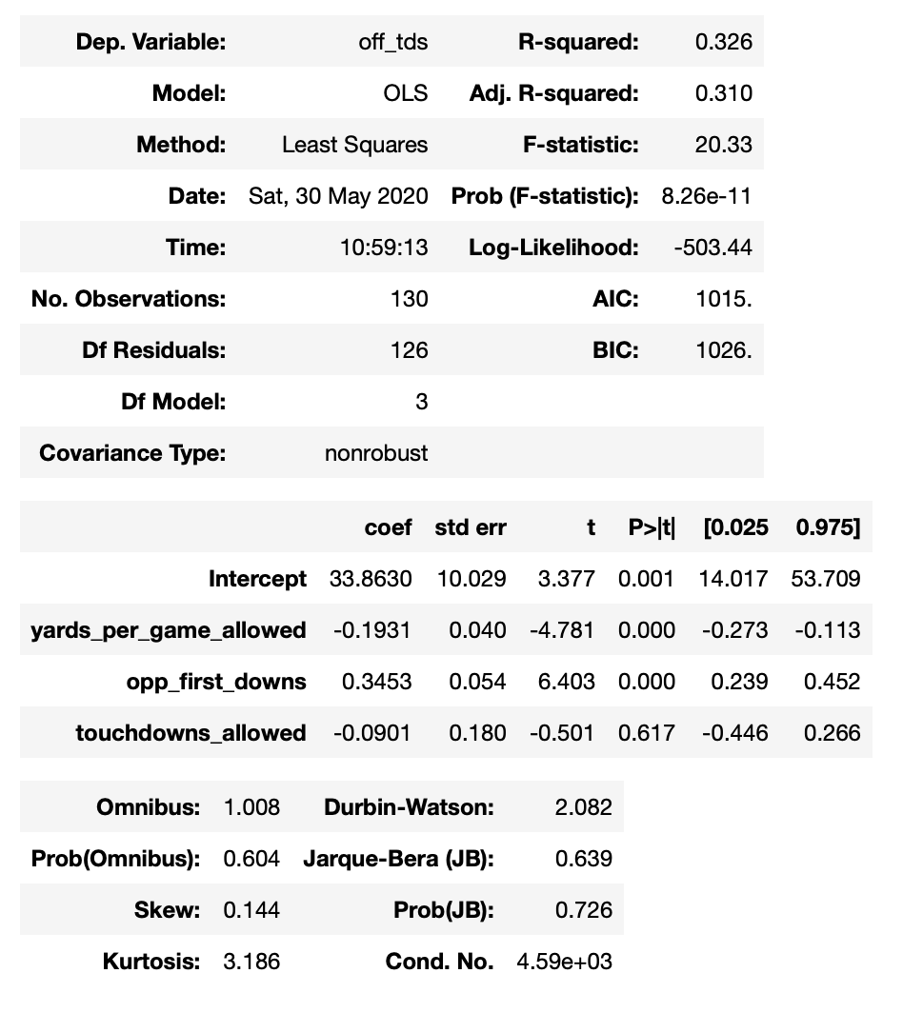
Multiple regression
Dependent variable:
Offensive Touchdowns
Explanatory variables:
Yards per Game Allowed
Opponent First Downs
Touchdowns Allowed

